Slide 1
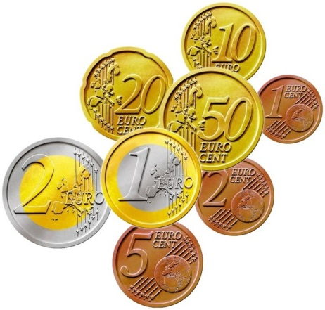
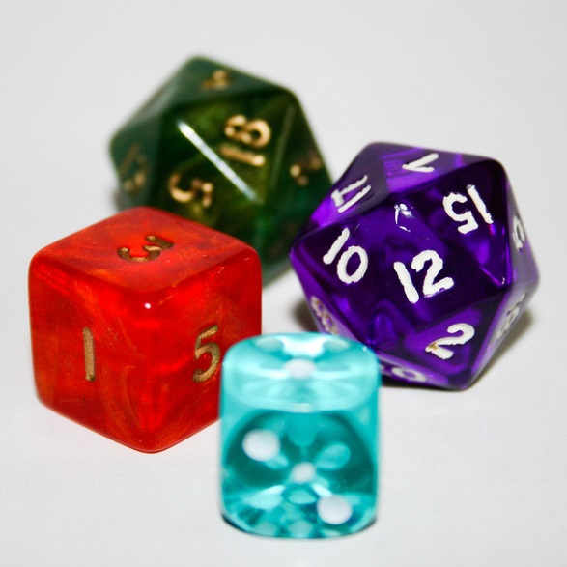
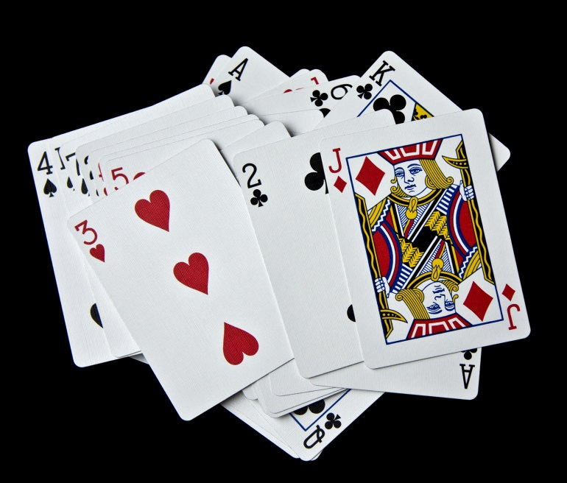
My Probability Interactive Notebook
Name
Class
Teacher Mr Evans
Term 2 Semester 1
1

Slide 2
Create your own front page
It needs to contain the following –
My number interactive notebook
Name
Class
Teachers Name
Semester 1 Term 1
Page number 1

Slide 3
Contents
Glossary or Formula Page
Page
Date
Description
2
3

Slide 4
Tasks
24
7
30
Essential Question
Questions
Notes
Summary
4
5

Slide 5
24
7
30
Date
Venn Diagrams
EQ – What is set notation we use with Venn Diagrams?
What is set notation?
Sets are simply collections of items. A set may contain your favorite even numbers, the days of the week, or the names of your brothers and sisters. The items contained within a set are called elements, and elements in a set do not "repeat". The elements of a set are often listed by roster. A roster is a list of the elements in a set, separated by commas and surrounded by French curly braces.
5

Slide 6
24
7
30
Date
Venn Diagrams
EQ – What is set notation we use with Venn Diagrams?
What is set notation?
Sets are simply collections of items. A set may contain your favorite even numbers, the days of the week, or the names of your brothers and sisters. The items contained within a set are called elements, and elements in a set do not "repeat". The elements of a set are often listed by roster. A roster is a list of the elements in a set, separated by commas and surrounded by French curly braces.
Let set A be the numbers 3, 6, 9. A = {3, 6, 9} (in roster notation) (5 is not in set A)
5

Slide 7
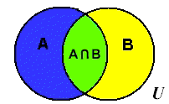
24
7
30
Date
Venn Diagrams
EQ – What is set notation we use with Venn Diagrams?
What is set notation?
Sets are simply collections of items. A set may contain your favorite even numbers, the days of the week, or the names of your brothers and sisters. The items contained within a set are called elements, and elements in a set do not "repeat". The elements of a set are often listed by roster. A roster is a list of the elements in a set, separated by commas and surrounded by French curly braces.
Let set A be the numbers 3, 6, 9. A = {3, 6, 9} (in roster notation) (5 is not in set A)
The Venn diagram at the left shows two sets A and B that overlap. The universal set is U. Values that belong to both set A and set B are located in the center region labeled where the circles overlap. This region is called the "intersection" of the two sets. (Intersection, is only where the two sets intersect, or overlap.)
5

Slide 8
24
7
30
Date
Venn Diagrams
EQ – What is set notation we use with Venn Diagrams?
What is set notation?
Let set A be the numbers 3, 6, 9. A = {3, 6, 9} (in roster notation) (5 is not in set A)
The Venn diagram at the left shows two sets A and B that overlap. The universal set is U. Values that belong to both set A and set B are located in the center region labeled where the circles overlap. This region is called the "intersection" of the two sets. (Intersection, is only where the two sets intersect, or overlap.)
The notation represents the entire region covered by both sets A and B (and the section where they overlap). This region is called the "union" of the two sets.
(Union, like marriage, brings all of both sets together.)
5

Slide 9

24
7
30
Date
Venn Diagrams
EQ – What is set notation we use with Venn Diagrams?
What is set notation?
The Venn diagram at the left shows two sets A and B that overlap. The universal set is U. Values that belong to both set A and set B are located in the center region labeled where the circles overlap. This region is called the "intersection" of the two sets. (Intersection, is only where the two sets intersect, or overlap.)
The notation represents the entire region covered by both sets A and B (and the section where they overlap). This region is called the "union" of the two sets.
(Union, like marriage, brings all of both sets together.)
If we cut out sets A and B from the picture above, the remaining region in U, the universal set, is labeled , and is called the complement of the union of sets A and B. A complement of a set is all of the elements (in the universe) that are NOT in the set.
5

Slide 10
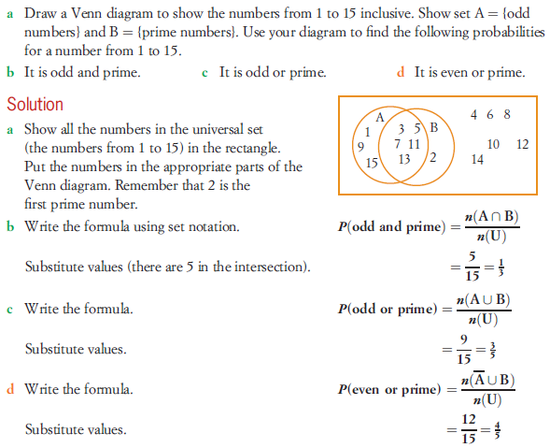
24
7
30
Date
Venn Diagrams
EQ – What is set notation we use with Venn Diagrams?
What is set notation?
5

Slide 11
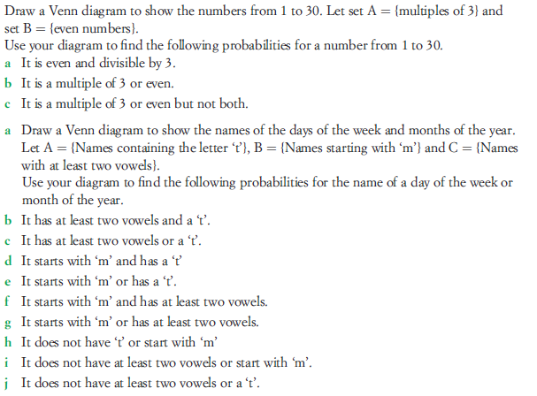
Task
1.
2.

Slide 12
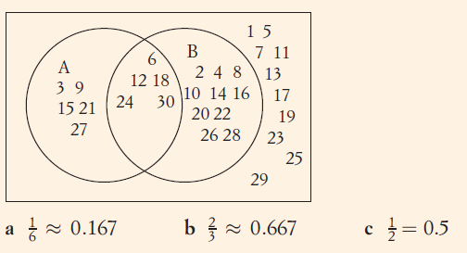
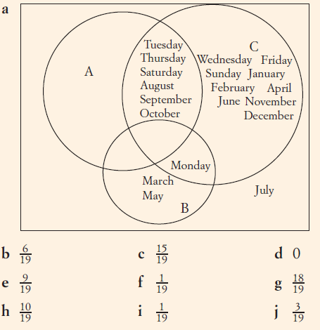
Answers
1.
2.

Slide 13
Notes Review
24, 7 ,30
Date
Title
Essential question
Notes complete
Notes complete with colour and diagrams
Questions completed
Contents page filed in
Formula page filled in

Slide 14
Homework
Review your notes and write a summary answering the essential question.

